Slide 1
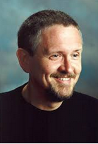
Ender’s Game
By: Orson Scott Card
NovelUnits: About the Author
Orson Scott Card was born in Richland, Washington, on August 24, 1951. He grew up in California and Arizona and traveled to Brazil to serve two years as an unpaid missionary for the Mormon Church. He graduated from Brigham Young University in 1975, and earned a master's degree in literature from the University of Utah in 1981. Card lives in Greensboro, North Carolina, with his wife, Kristine. They have five Children. His official web site is www.hatrack.com.
In 1977, Card wrote a short story, "Ender's Game," which he later expanded to a full-length novel. It won both the Hugo and Nebula awards in 1986. Its sequel, Speaker for the Dead, won both awards the following year. The third novel in the series, Xenocide (1991), was followed by Children of the Mind (1996).
A parallel series features the same world with Bean as the main character, and other children of the Battle School figure prominently. Those books are: Ender's Shadow, Shadow of the Hegemon, and Shadow Puppets.
Why does Graff ask Ender three times if he wants to go to Battle School?

Slide 2

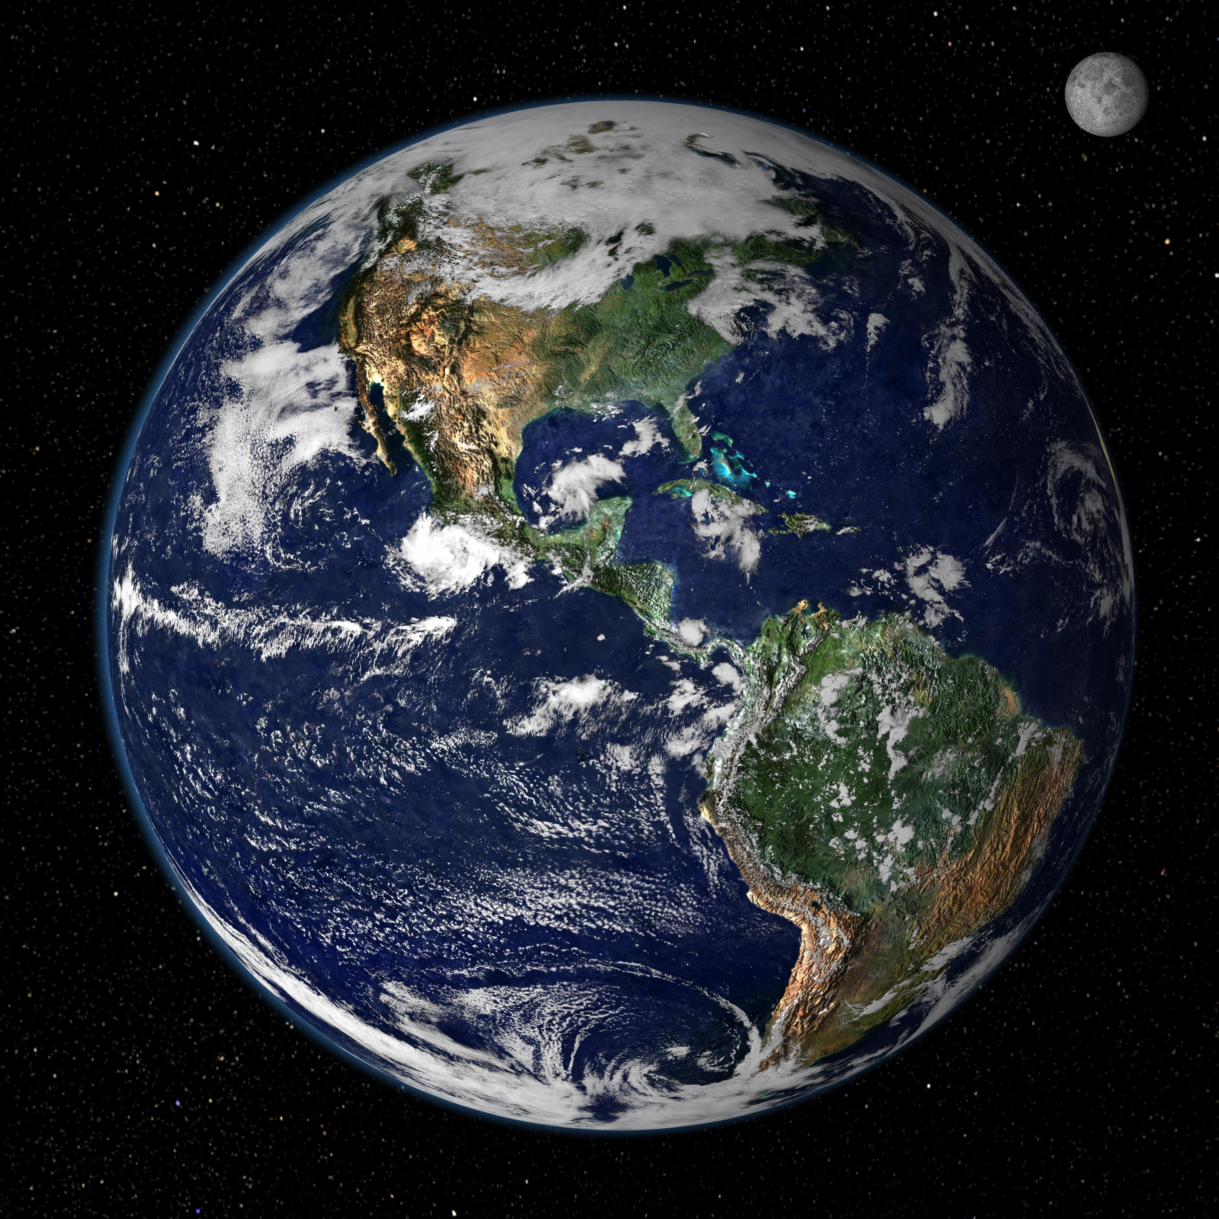
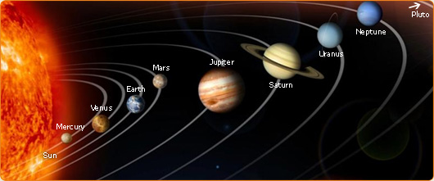
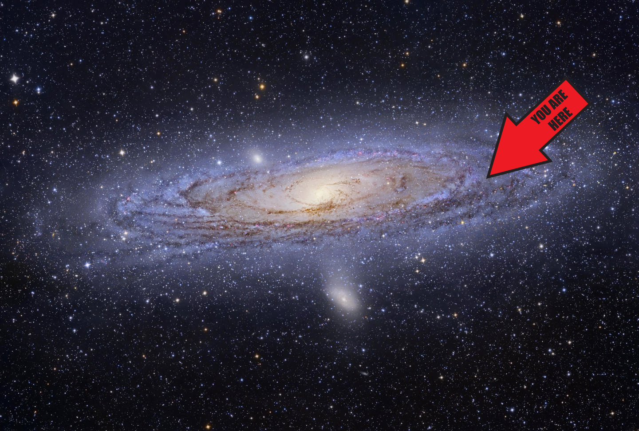
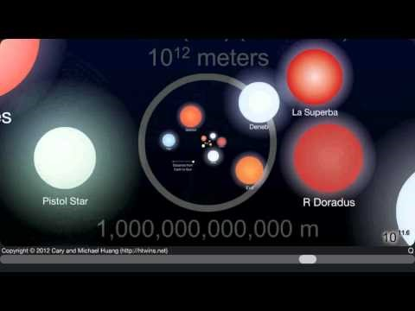
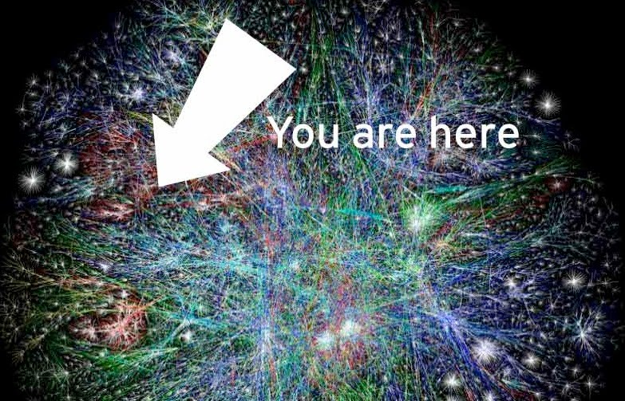
Map of the Milky Way Galaxy
The Scale of the Universe 2 – 00:03:24
Map of the Universe

Slide 3

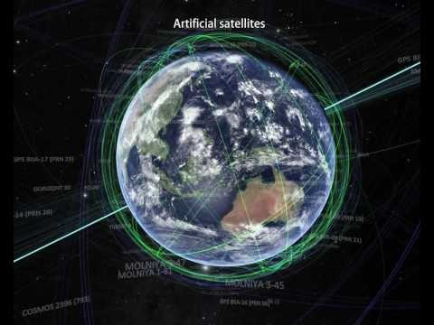
Explore the Vastness of the Universe!
Incomprehensible: The Vastness of Space – 00:04:53
The Known Universe by AMNH – 00:06:30

Slide 4
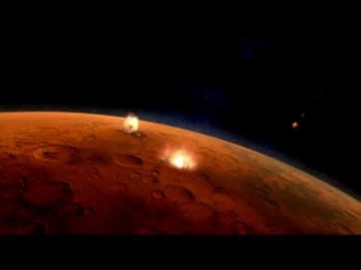
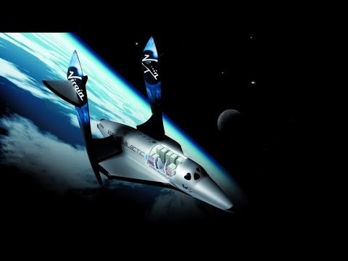

Space Travel Anyone?
Colonizing Mars – 00:04:39
The Universe: Space Travel Documentary – 00:44:06
5 Real Possibilities for Interstellar Travel – 00:13:02

Slide 5
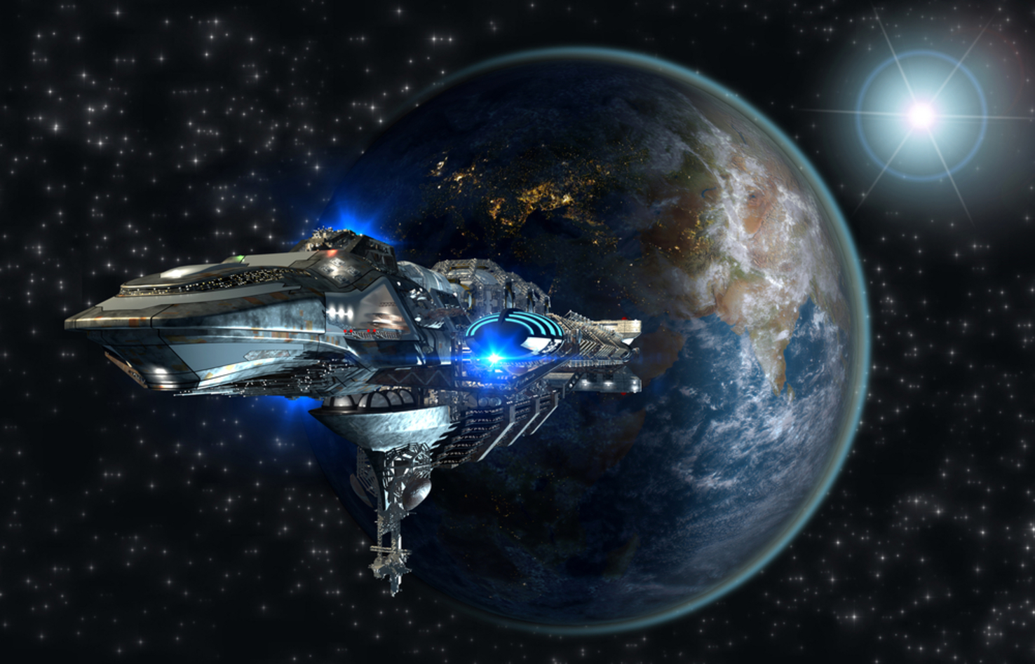
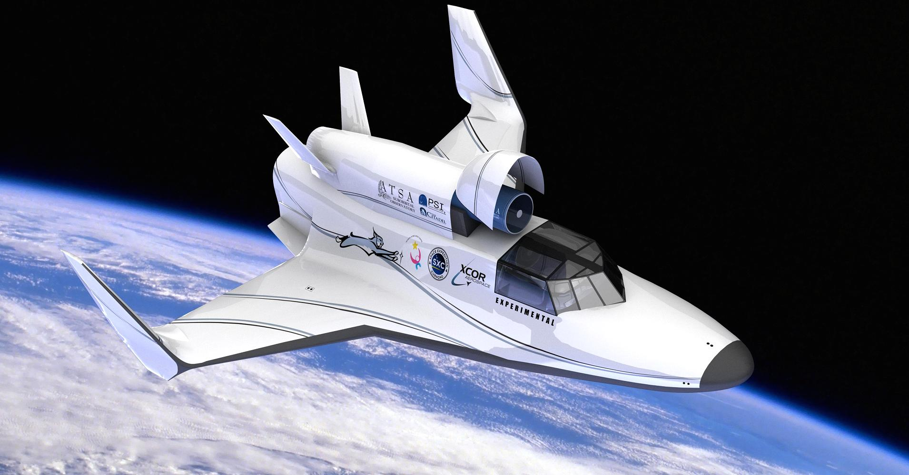

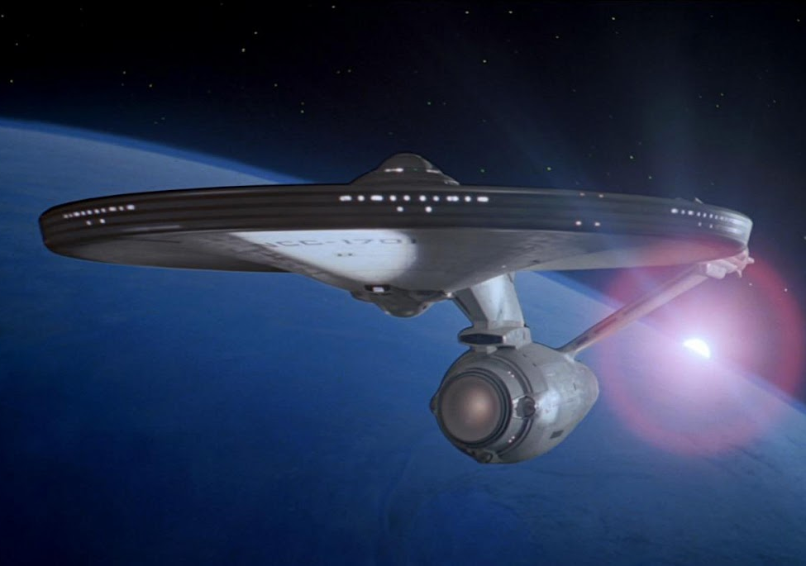
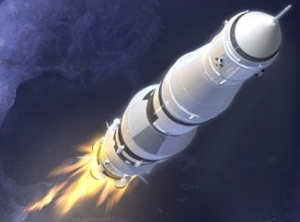
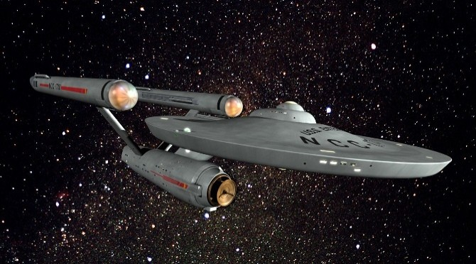
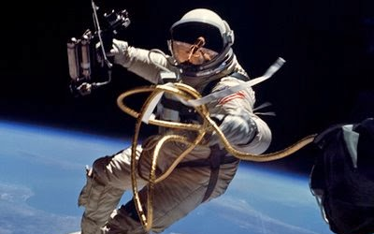
POD TALK: How do you feel about the vastness of the universe and space travel?
Each pod take 1 minute to brainstorm your answer.
Each pod member will take turns (1 -> 4) sharing their personal feelings on the topic.
The pod will construct a 2-3 sentence response which accurately expresses the pod’s overall feelings toward the vast universe and space travel.

Slide 6
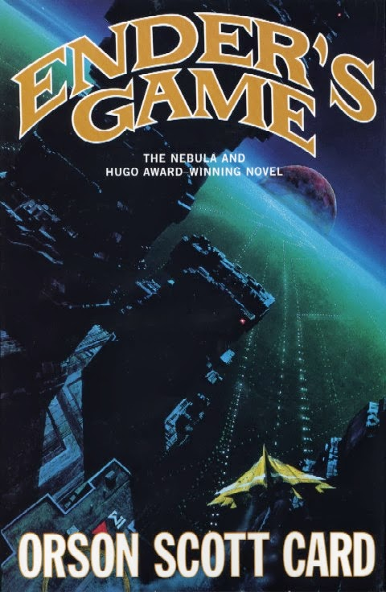


SYNOPSIS:
Humanity, having begun to explore the Universe and master interplanetary spaceflight, encounters an alien race dubbed the "buggers". The discovery of a bugger forward base in the asteroid Eros leads to war between the species and the destruction of a bugger colonizing force. The battle to recapture Eros results in the discovery of advanced alien technology, including gravity manipulation. Political conflicts on Earth between three ruling parties, the Hegemon, Polemarch, and Strategos, are put aside in the face of the threat from the buggers. Ostensibly in preparation for the expected third invasion, an International Fleet (I.F.) is established, with headquarters on Eros. Increasingly advanced starships are built and secretly launched to attack the buggers' home worlds. To develop commanders capable of defeating the much larger bugger forces, the I.F. creates a crash training program for children with the best strategic minds, the Battle School.

Slide 7
Ender’s Game Prediction Chart
On a blank piece of notebook paper, create a chart like the following. Be sure to include the appropriate headings to each column. At the beginning of each reading, you will take a few minutes to fill in information in your prediction chart. Your prediction questions for each reading are in your study guide.
Today’s Reading Chapter/Pages | What characters have we met so far? CHARACTERS | What is the conflict in the story? CONFLICT | Restate today’s prediction question. PREDICTION | Why did you make these predictions? WHY? | Were your predictions correct? CORRECT?
Chpt 1 & 2 Pg start-Pg end
Chpt 3 & 4 Pg start-Pg end
… Etc.

Slide 8
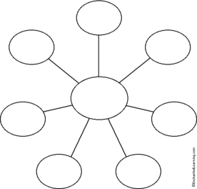
Character Attribute Web
What Ender says:
Create a web for Andrew Wiggin (aka Ender)
You may choose to make additional webs for the following characters to help you with your story analysis and summary (additional completed webs will be worth extra credit):
Peter Wiggin
Valentine Wiggin
Colonel Hyrum Graff
Bean
Bonzo
Alai
Petra
Mazer Rackham
What Ender thinks:
What Ender does:
Environment (School/Home/Battle School):
Andrew Wiggin
“Ender”
What others do to Ender:
Authority interaction or inaction and how it affects Ender’s decisions:
Other conflicts that affect Ender:

Slide 9
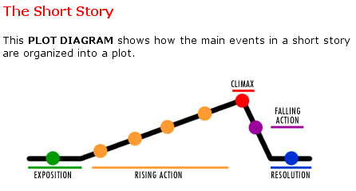
Story Map – Plot Diagramming
While reading the story, you will need to take QUALITY notes on the sequence of events. Be sure to record all information for the exposition (setting, characters, situation) as it is encountered. Along with your notes, use our discussion and study guide questions to help you keep track of when events occur in the story. One of your final assessments will be to construct a plot diagram of Ender’s Game.

Slide 10
Discussion Question RoundRobin
During the reading, a series of discussion questions will be posted. Each pod will be responsible for an assigned question. At the end of each chapter, you will have 30 seconds to think about your questions before responding.
After our “think time”, each pod member will respond for 30 seconds:
Pod Member 1: Share response with pod/Take notes
2: Build on 1’s response
3: Build on 2’s response
4: Add additional thoughts or questions you still have
(Alternate which pod member begins the discussion with each question:
2 →3 →4 →1 … 3 → 4 → 1 → 2 … etc)
After 2 minutes of pod discussion, the pod will be given 1 minute to prepare a response.
*Which pod and pod member is called on to respond will be done at random*
***ALL pod members MUST be prepared to respond to each discussion question***

Slide 11
Practice Discussion RoundRobin
All Pods: Based on what we have learned about Ender’s Game so far, what do you predict will be the outcome of the story?
30 seconds “Think Time”
Each pod member responds for 30 seconds:
Pod Member 1: Share response with pod/Take notes
2: Build on 1’s response
3: Build on 2’s response
4: Add additional thoughts or questions you still have
1 minute for pod to form a response
*Which pod and pod member is called on to respond will be done at random*
***ALL pod members MUST be prepared to respond to each discussion question***

Slide 12






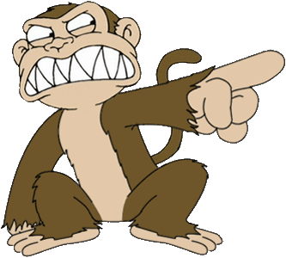
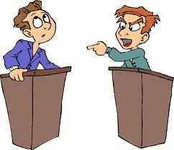
Ender’s Game Vocabulary: Chapters 1 and 2
authorized (pg. 12): to have authority or permission
convict (pg. 13): to find guilty of a crime
glint (pg. 2): a brief flash or flicker of reflected light
opponent (pg.7): one who is against another
pathetic (pg. 12): miserable, ineffective, and inadequate
prediction (pg. 2): the act of telling the future
silhouetted (pg. 15): a profile; a dark figure seen against a light background
vengeance (pg. 7): injury or damage done in return for injury or damage received; done in revenge

Slide 13
Chapter 1 Discussion Questions
Pod 1 and 2.) Who is talking at the beginning of each chapter? Why is the type in different print?
Pod 3 & 4.) Ender thinks, “Sometimes lies were more dependable than the truth.” Why does he think this?
Pod 5.) Ender returns to class and confuses Stilson with Peter. What does this reveal about Ender’s present state?
Pod 6 & 7.) Although he knows it’s forbidden to strike someone who’s already on the ground, Ender kicks Stilson. Why? What does this say about Ender’s character?

Slide 14
Chapter 1 Discussion Responses
Pod 1 and 2.)
1st) Monitor/government – is an important part to the storyline
2nd) ditto
7th) Same and because it is a different point of view than the rest of the story.
Who is talking at the beginning of each chapter? Why is the type in different print?
Pod 3 & 4.)
1st) Adults believe that telling a lie will protect you from a painful truth. Ender has learned, because of this, it is often easier to understand when an adult is lying.
2nd) Sometimes adults lie to protect our feelings or keep us from being afraid.
7th) ditto
Ender thinks, “Sometimes lies were more dependable than the truth.” Why does he think this?

Slide 15
Chapter 1 Discussion Responses
Pod 5.)
1st) He has the feeling of something he has lost or cannot find. He was in a state of confusion.
2nd) He was confused. Both Peter and Stilson are bullies, they’re dangerous.
7th) He recognizes both as enemies and in his state of confusion cannot remember which enemy Stilson is.
Ender returns to class and confuses Stilson with Peter. What does this reveal about Ender’s present state?
Pod 6 & 7.)
1st) He is smart, vengeful because he is scaring off the other children.
2nd) He wanted to win all the fights in one, not continue to fight the same fight every day.
7th) He wanted to make sure he won every future fight against the gang, not just the one for that day against Stilson.
Although he knows it’s forbidden to strike someone who’s already on the ground, Ender kicks Stilson. Why?
What does this say about Ender’s character?

Slide 16
Chapter 1 Discussion Responses (Teacher’s Guide)
1. Who is talking at the beginning of each chapter? Why is the type in different print?
It must be government officials observing Ender through his monitor. They type is different to show division of the government observation and Ender’s point of view.
2. Ender thinks, “Sometimes lies were more dependable than the truth.” Why does he think this?
Adults tell him one thing, but experience has taught him that the opposite is usually true. For example, he is told that removing the monitor won’t hurt, but he knows that it will.
3. Ender returns to class and confuses Stilson with Peter. What does this reveal about Ender’s present state?
He’s confused and can’t remember things, but he associates Stilson, the bully, with his brother. He knows they are both his enemies.
Although he knows it’s forbidden to strike someone who’s already on the ground, Ender kicks Stilson. Why? What does this say about Ender’s character?
He is smart and knows he will face Stilson and his gang again and again if he doesn’t stop the harassment now.

Slide 17
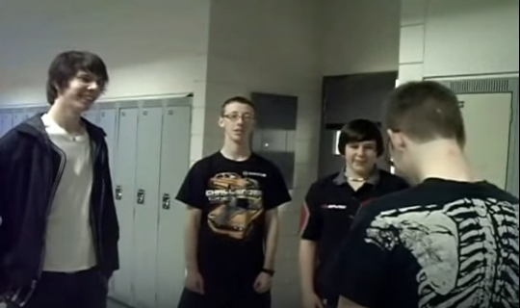
Ender’s Game Scene Re-Enactment: Stilson Bully
https://youtu.be/JJrZvH892co
Students in an English/Language Arts class re-enact the “Stilson Bully Gang” scene from the book, Ender’s Game.
Students reproduce the effect of “dubbed” video (when voice actors are used to translate dialog in a film from another language).

Slide 18
Chapter 2 Discussion Questions
Pod 1 and 2.) Government observers want to see how Ender will react to his brother, not what his angry brother will do to him. Why?
Pod 3 & 4.) Does Ender believe Peter when he says the threat to kill him and Valentine was a joke?
Pod 5, 6, & 7.) Twice, Ender cries; after the fight with Stilson and after his brother apologizes to him. What does Ender crying at these times say about his character?

Slide 19
Chapter 2 Discussion Responses
Pod 1 and 2.)
1st) The gov. wants to see how he will react when he is in danger to be sure he will succeed in Battle School. The whole situation was set up as a test to see what his motives for violence are.
2nd) To know what he is thinking when he fights. They know Peter is violent, so they needed to be sure Ender was acting in self-defense and not for the sake of being violent.
7th) That was the final test, and they wanted to see if he would buckle under pressure. They want to see how much like Peter he is, because Peter was not accepted due to his violent nature.
Government observers want to see how Ender will react to his brother, not what his angry brother will do to him. Why?
Pod 3 & 4.)
1st) No, because Peter was kicked out of the program for being too violent. Also, Peter was acting violently (sitting on him, pushing his groin) while threatening Ender.
2nd) No, because Peter is violent and dangerous. He has behaved this way through childhood.
7th) No, because Peter was physically hurting him when he was saying it, pressing on his chest with his knee.
Does Ender believe Peter when he says the threat to kill him and Valentine was a joke?

Slide 20
Chapter 2 Discussion Responses
Pod 5, 6, & 7.)
1st) Ender tries to be tough but also still has a soft side. He is ashamed of what he did during his fight with Stilson.
2nd) He does not like being violent. He is very sensitive.
7th) He only cries when he is in pain or if he has done something he is not proud of.
Twice, Ender cries; after the fight with Stilson and after his brother apologizes to him.
What does Ender crying at these times say about his character?

Slide 21
Chapter 2 Discussion Responses (Teacher’s Guide)
5. Government observers want to see how Ender will react to his brother, not what his angry brother will do to him. Why?
They want to see if Ender will fight Peter or if he will respect the family tie that binds them.
6. Does Ender believe Peter when he says the threat to kill him and Valentine was a joke?
He’s uncertain. He believes his brother is a murderer at heart, but he doesn’t know if Peter would actually kill him.
7. Twice, Ender cries; after the fight with Stilson and after his brother apologizes to him. What does Ender crying at these times say about his character?
He’s tenderhearted, and he knows when he’s done something wrong. He doesn’t like what he or his brother have turned into.

Slide 22

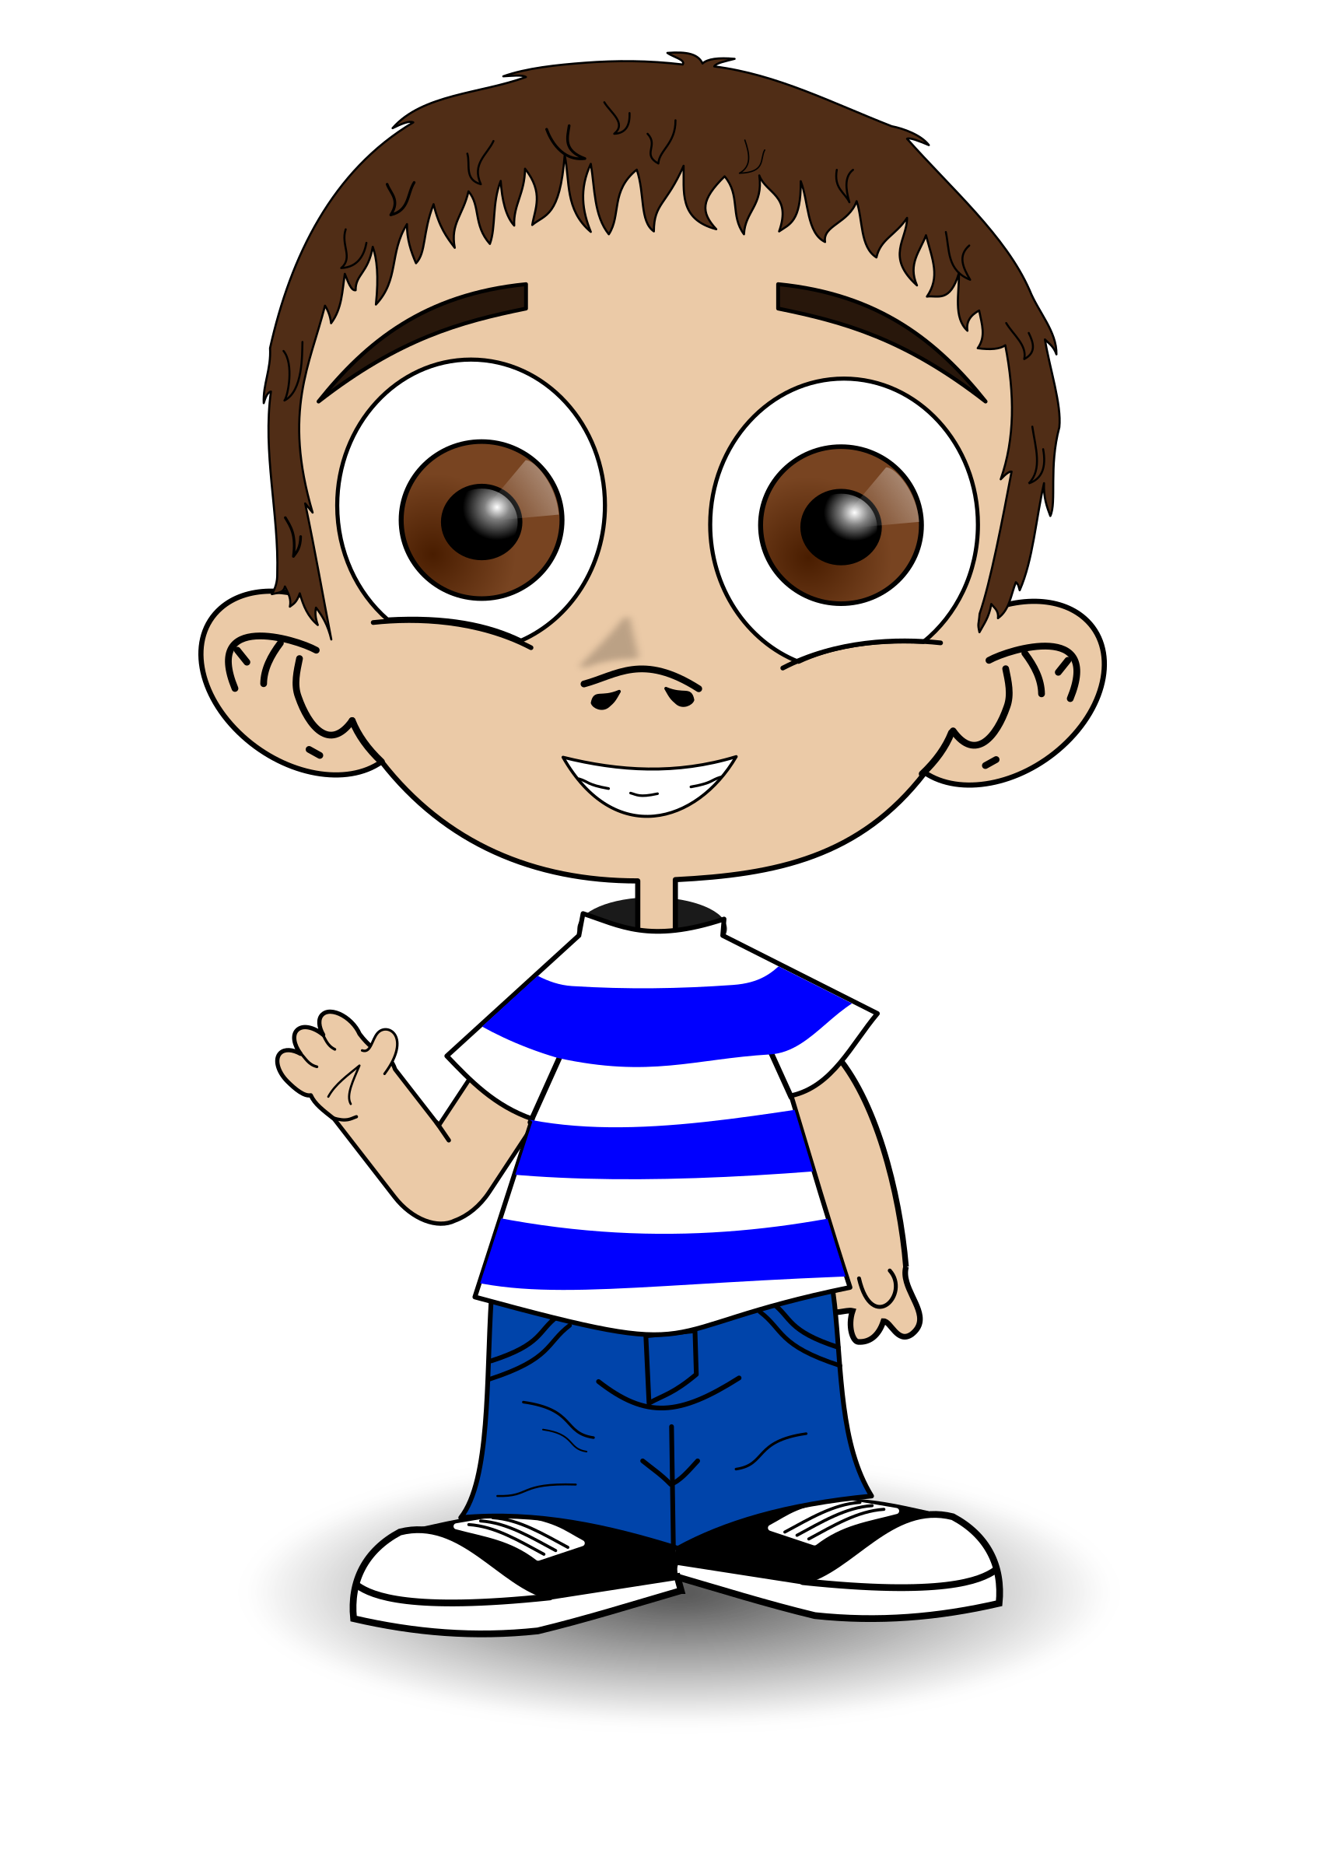







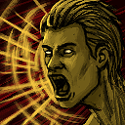
Ender’s Game Vocabulary: Chapters 3 and 4
ambiguous (pg. 22): unclear; open to interpretation
bluntly (pg. 35): speaking without polite consideration of other’s feelings
classified (pg. 20): officially secret; only authorized people have access
disorientation (pg. 28): a state of confusion experienced mentally or physically
humanity (pg. 32): one’s human awareness and state of compassion and dignity
juvenile (pg. 17): of or relating to a young person
motivation (pg.20): one’s reason for an action or behavior
requisitions (pg. 20): official orders
significance (pg. 30): worthy of attention; something’s state of importance
taunted (pg. 18): provoked with insulting remarks

Slide 23
Chapter 3 Discussion Questions
Pod 1 and 2.) Graff says it isn’t the fight that earned Ender an invitation to enter Battle School, it was why he fought as he did. Why is this important?
Pod 3 & 4.) Ender is told that all who want to make it through the first year make it. What does this mean?
Pod 5.) Ender’s family dynamics are very complicated. Do his parents want him to stay home or not? Do his brother and sister want him to go?
Pod 6 & 7.) Why does Graff ask Ender three times if he wants to go to Battle School?

Slide 24
Chapter 3 Discussion Responses
Pod 1 and 2.)
1st) To see if he was fighting for fun or for defense. He fought the way he did because if he had not, he would have continued to get bullied by Stilson and gang.
2nd) He was not wanting to fight, he was just defending himself. IF wants to be sure he will be a defender of humanity. Graff wanted to be sure he was fighting for the right reasons and not just to be violent.
7th) Shows he has wisdom and thinks before he acts. They want to make sure he is not going to just fight to be fighting, but acts out of necessity or self-defense.
Graff says it isn’t the fight that earned Ender an invitation to enter Battle School, it was why he fought as he did. Why is this important?
Pod 3 & 4.)
1st) As long as you try, you will make it.
2nd) If you try hard and are determined to succeed, you will make it. It is similar to college, if you work hard and are dedicated, you will be successful.
7th) If at first you don’t succeed, try try again. You need to be determined to be successful. If you try hard you will be able to get through the first year.
Ender is told that all who want to make it through the first year make it. What does this mean?

Slide 25
Chapter 3 Discussion Responses
Pod 5.)
1st) Parents are embarrassed because they have a third, but they do love him and would never admit they want him to go. His brother is anxious for him to be gone, and Valentine wants him to stay.
2nd) Parents – No because they love him and are afraid of him/Yes, because he is a source of tension in the home because he is a Third. Peter – No, because he is jealous. Val – No, because she loves him.
7th) Mom and dad love him and want him to stay, but the fact that he is a third causes problems for the family, and though they would not admit it, life would be easier if he were gone. Peter wants Ender to leave, because he is jealous of him, but he is also upset he is the one chosen to go to Battle School. Valentine does not want him to go because she loves Ender.
Ender’s family dynamics are very complicated. Do his parents want him to stay home or not?
Do his brother and sister want him to go?
Pod 6 & 7.)
1st) To make sure Ender was volunteering to go to Battle School because it is dangerous and he would be risking his life.
2nd) He wanted to make sure he was ready and that him going to BS was voluntary.
7th) To make sure Ender understand the decision he is making and that he will not change his mind.
Why does Graff ask Ender three times if he wants to go to Battle School?

Slide 26
Chapter 3 Discussion Responses (Teacher’s Guide)
1. Graff says it isn’t the fight that earned Ender an invitation to enter Battle School, it was why he fought as he did. Why is this important?
Ender thinks past the current situation and understand future consequences of actions.
2. Ender is told that all who want to make it through the first year make it. What does this mean?
Those who dedicate themselves to something will succeed. This applies to most situations in life. If a person wants something badly enough, he will achieve it.
3. Ender’s family dynamics are very complicated. Do his parents want him to stay home or not? Do his brother and sister want him to go?
Ender’s parents are from noncompliant families who had more than two children. They were proud to be allowed three children, but they did not have more even though they wanted to. They have mixed feeling about Ender leaving – they love him and will miss him, but they are also relieved to be rid of the stigma of having a Third. Peter is jealous of Ender and wants him out; Valentine loves him and wants him to stay.
4. Why does Graff ask Ender three times if he wants to go to Battle School?
It is a huge decision, and Graff wants Ender to go for the right reason – to serve.

Slide 27

WELCOME TO BATTLE SCHOOL

Slide 28
Chapter 4 Discussion Questions
Pod 1 and 2) Why does Graff single Ender out and make the other boys dislike him?
Pod 3 & 4) Ender reacts to the blows on the head by anticipating his attacker’s movement and flipping him forward. After the boy is hurt, Ender feels terrible. What does this say about his character?
Pod 5, 6 & 7) Why doesn’t Graff admit to Ender what he tells Anderson: “The kid’s wrong. I am his friend”?

Slide 29
Chapter 4 Discussion Responses
Pod 1 and 2)
1st) To show the other boys Ender is better than all of them. He wants to show them one day he might be their leader and that he has the skills and capabilities of doing so.
2nd) So if he is bullied, he could see if Ender would defend himself.
7th) Graff believes in order for Ender to be successful as a leader, he must feel like he has to solve his problems on his own and cannot count on anyone coming to “save” him.
Why does Graff single Ender out and make the other boys dislike him?
Pod 3 & 4)
1st) Ender doesn’t like hurting people but he will do so in self-defense.
2nd) It shows he does not like to hurt people. That he is a good fighter but does not want to fight. He will use violence in self defense even though he does not like being violent.
7th) He does not like hurting people, but he understand he must protect himself and sometimes violence can be the only way to stop an enemy.
Ender reacts to the blows on the head by anticipating his attacker’s movement and flipping him forward.
After the boy is hurt, Ender feels terrible. What does this say about his character?

Slide 30
Chapter 4 Discussion Responses
Pod 5, 6 & 7)
1st) So Ender isn’t so heartbroken when Graff trains him (breaks him down to build him up). Tries to isolate Ender to make him stronger by realizing he (Ender) is the only person he can count on (no friends).
2nd) He wants Ender to be tough and self-reliant in Battle School – not to depend on others (friends) to “save” him in difficult situations.
7th) He wants Ender to feel alone and isolated, because he needs Ender to be serious in order to lead. Amend: He wants Ender to feel alone, and if he were to tell him he was his friend, Ender would count on being “saved” from conflicts. Graff needs him to prove he can figure out how to resolve issues on his own.
Why doesn’t Graff admit to Ender what he tells Anderson: “The kid’s wrong. I am his friend”?

Slide 31
Chapter 4 Discussion Responses (Teacher’s Guide)
5. Why does Graff single Ender out and make the other boys dislike him?
He wants to see how Ender will react, and he feels it’s the only way to make Ender be a creative leader.
6. Ender reacts to the blows on the head by anticipating his attacker’s movement and flipping him forward. After the boy is hurt, Ender feels terrible. What does this say about his character?
Ender does not to be violent, but he will take the most drastic measures in self-defense to end a battle.
7. Why doesn’t Graff admit to Ender what he tells Anderson: “The kid’s wrong. I am his friend”?
If Graff were to admit to Ender that he is his friend, Ender would rely on him to “save” him when he experiences conflict. Graff is trying to train Ender to be the best commander possible, which includes making sure his decisions are based on his understanding that no one else will be there to “save” him. In the real war, there will be no mom and dad or Graff to step in and win the battle. He will need to make decisions on his own for the safety of himself and his crew.

Slide 32
Character Attribute Web: Chapters 1-4
f
What Ender thinks:
What Ender says:
What Ender does:
Has to win the fight with Stilson for all time, not just this once, or will fight it every day.
Continuing to harm a helpless enemy is some-thing animals do.
Thinks Graff is his friend because he is nice and honest.
“…just remember what I do to people who try to hurt me. It wouldn’t be this bad … it would be worse.”
“Take away my monitor and I am just like Peter.” (p38)
“Knocking him down won the first fight. I wanted to win all the next ones, too. So they’d leave me alone.
Repeatedly kicked Stilson while he was down.
Chooses to go with Graff to Battle School in hopes of saving humanity, even though Graff explains how difficult it will be.
Easily reorients himself to the idea of null gravity.
Grabs boy’s arm on launch ship who is hitting him. Flips him out and over the seat and breaks his arm.
Environment (School/Home/Battle School):
What others do to Ender:
Bullied at school by Stilson and his gang.
Bullied at home by brother Peter.
Sister Valentine loves him and visa versa.
Stilson and his friends ganged up on Ender after school because he no longer had his monitor.
Peter makes Ender be the bugger in a game – threatens to kill him – apologizes when he thinks Ender is asleep.
Andrew Wiggin
“Ender”
Mom and dad love him, but his presence reminds them they are afraid to be noncompliant.
Authority interaction or inaction and how it affects Ender’s decisions:
Other conflicts that affect Ender:
Monitor off, Ender believed no one would interfere in the fight against Stilson.
Futuristic society where families are only allowed to have 2 children, Ender is a THIRD, requisitioned by the government in hopes to create a military leader. Thirds and their families are generally looked down upon. This is one reason there is conflict between Ender and both Stilson and Peter.
Ender is monitored to see how he reacts to Peter if he believes no one will interfere.
Graff informs Ender the final step in his testing was to see what would happen when the monitor came off.
Graff isolates Ender from the other launchies in hopes to make him a more effective soldier/leader.

Slide 33
Prediction Question Chapter 1-4
1-2: Do you think Peter will actually try to kill Ender?
3-4: How will Ender make the other boys respect him?
Chapter/Pages | CHARACTERS | CONFLICT | PREDICTION | WHY? | CORRECT?
Chpt 1 & 2 Pg 31 – Pg 45 | Andrew Wiggin Stilson Peter Valentine | Ender v Stilson (CvC) Ender v Peter (CvC) Ender examining what his actions against Stilson mean (CvSe) | I predict Peter will/will not try to kill Ender. | I predict this because… … reason 1 … reason 2 … etc
Chpt 3 & 4 Pg 46 - 68 | Mom/Dad Graff | Ender v Decision to go to Battle School (CvSe/CvSo) | I predict Ender will make the other boys respect him by … | I predict this because… (refer to all GO’s, notes, and the text to support your reason)

Slide 34
STORY MAP: Chpt 1-2
STORY MAP: Chpt 3-4
Ender gets monitor removed.
IF Officer Colonel Hyrum Graff visits the Wiggin home to find out what Ender’s motives were for the way he fought Stilson. He then tells the family Ender has been accepted to Battle School after all.
Stilson and gang corner Ender after school and start a fight. Ender thoroughly beats Stilson by continuing to kick him while he is down (chest, ribs, groin, face).
Graff and Ender have a private conversation where Graff explains the difficulties he will face at Battle School as well as the reasons his family is conflicted about him going (mom and dad come from noncompliant families and Ender being a third is a source of tension in their home.)
Ender feels bad for being put in the position where he was forced to defend himself. Realizes without the monitor he acts just like “Peter”
Ender agrees to go to Battle School with the hopes of being able to help save humanity/Earth.
Peter and Ender play a game of bugger vs. astronauts. Peter hurts Ender (toe in groin/kneels on chest) and threatens to kill Ender and Valentine “one day”
During the launch, Graff isolates Ender from the other launchies by telling them Ender is the best of the best, and the only one who has any brains. One boy hits Ender repeatedly on the head and he defends himself by flipping the boy over the seat and breaking his arm.
Peter apologizes for threatening to kill them while he thinks Ender is sleeping.
Ender is upset Graff set him apart from the other boys because he though he was his friend. Graff explains his job is not to be his friend, but to produce the best soldiers in the world.

Slide 35
Chapter 1-2 Study Guide Questions
What is Ender’s first name? Andrew
Where is Ender’s monitor at the beginning of the story? In the back of his neck
Who is Peter? Ender’s brother
What does Ender doodle on his desk? A contour map of mountainous islands
What letters march across Ender’s desk? THIRD
How does Stilson know Ender’s monitor has been removed? Because of the bandaid on his neck
Where does Ender kick Stilson? In the breastbone, the ribs, the groin, and the face
How old were Valentine and Peter when they lost their monitors? Valentine was 3, and Peter was 5
What is a bugger? An alien
What does Ender put on for the war game? A bugger mask
What does Peter threaten to do to Ender? Kill him

Slide 36
Chapter 3-4 Study Guide Questions
Who do the observers feel is the weak link? Why? Valentine; because Ender loves her
How does the family know someone is at the door? The table beeps
Who is at the door? Colonel Hyrum Graff of the International Fleet
What does Ender do after he explains the fight to Colonel Graff? He cries
What is Graff’s job? Director of primary training at Battle School in the Belt
Who comes from noncompliant families? Ender’s mom and dad – both came from families with more than 2 children
Who was the hero of the last bugger war? Mazer Rackham
How long has it been since the last war? 80 years
Why can’t Ender laugh when he’s with the other boys going to the launch? He’s afraid
Why is Ender hungry before the launch? He couldn’t eat 20 hours before the launch.
Who does Graff say is the only boy with brains on the launch? Ender
What happens to the boy Ender flips? His left arm is broken.
Why did Ender think Graff was his friend? He didn’t lie to him.

Slide 37
Homework Over the Weekend: Chapter 1-4
Finish filling in your prediction chart
Finish filling in your character attribute web
Finish filling in your story map
Writing Prompt (Chpt 3 & 4):
Pretend that you are Peter or Valentine and write a letter to Ender on the day that he is taken to Battle School. (*DUE MONDAY – @least ½ page*)
You may be able to find a copy of the full text online to help you over the weekend.
Search Google: Ender’s Game full text

